Slide 1
Querying NYC Tax Lot Data
Jason Danforth
Diane Ferrrera
Brittani Kauf

Slide 2

Project Requirements
ArcGIS REST API
Geocoding and Geospatial mapping
PLUTO (Primary Landuse Tax Lot Output)
PostGres & SQLite Database
Urban_planning
850,000+ Rows
70+ Data Fields
Flask App
@app.route (‘/home’)

Slide 3

Query Attributes
ZIP CODE
Valid for one of the addresses assigned to the tax lot.
Tax lots may have multiple addresses and these addresses may not have the same ZIP CODE. For example, a building with entrances on two streets may have a different ZIP CODE for each street address.
01
Land Use
A code for the tax lot's land use category.
The Department of City Planning has created 11 land use categories and assigns each BUILDING CLASS to the most appropriate land use category.
02
Year Built
The year construction of the building was completed, according to the Department of Building’s permits.
In general, YEAR BUILT is accurate for the decade, but not necessarily for the specific year.
For example, between 1910 and 1985, the majority of YEAR BUILT values are in years ending in 5 or 0, and a large number of structures built between 1800s and early 1900s have a YEAR BUILT between 1899 and 1901.
03
04
Number of Floors
The number of full and partial stories starting from the ground floor, for the tallest building on the tax lot.
Above ground basements are not included in the NUMBER OF FLOORS.

Slide 4
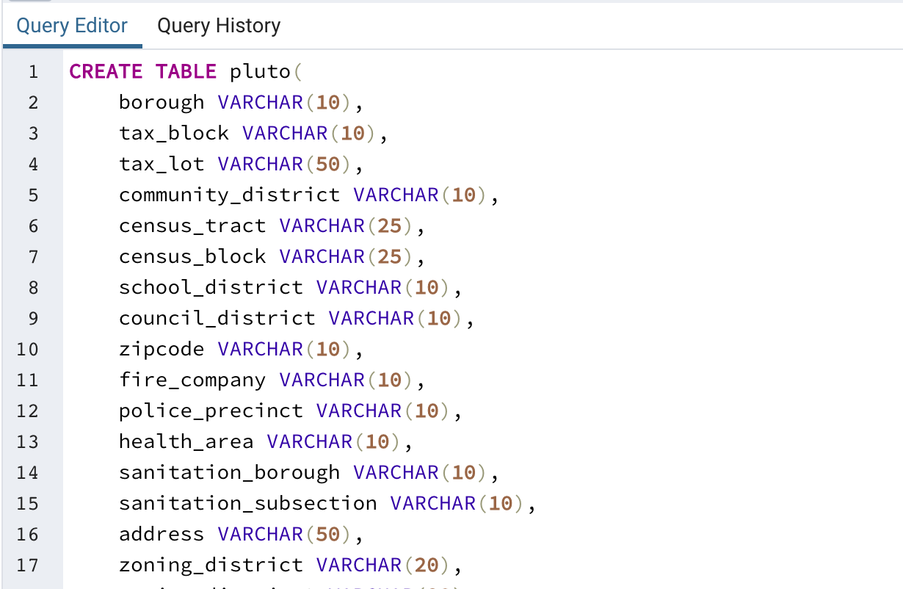

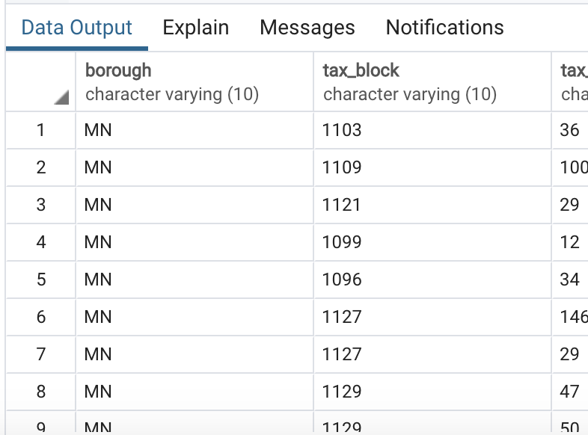
SQL Database Queries

Slide 5
Data Queries
 | AVG year_built |  | 1955
 | DISTINCT zipcodes |  | 71
 | AVG number_of_floors |  | 18
 | MAX number_of_foors |  | 90

Slide 6
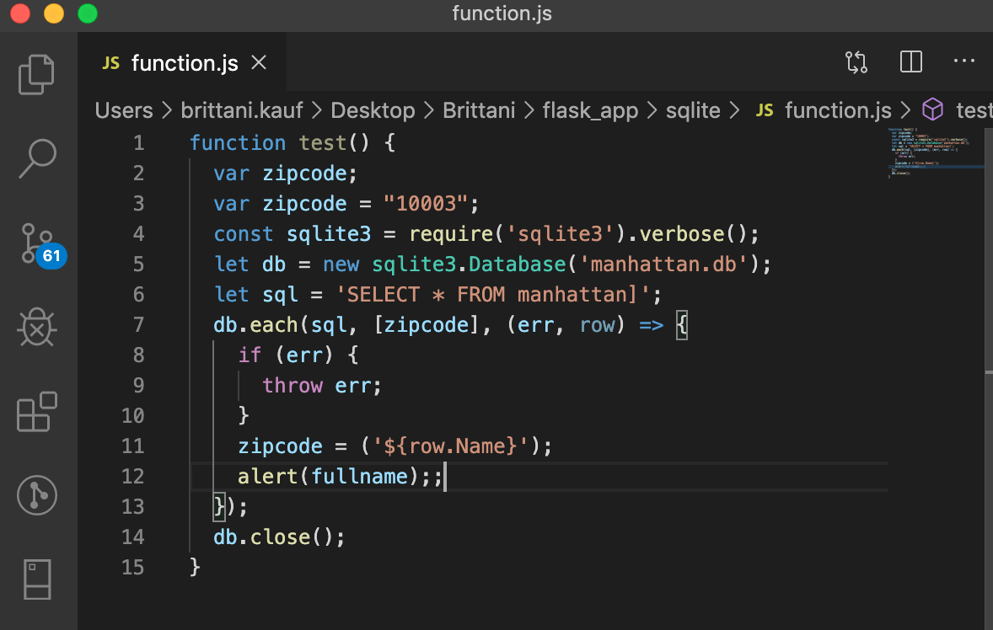
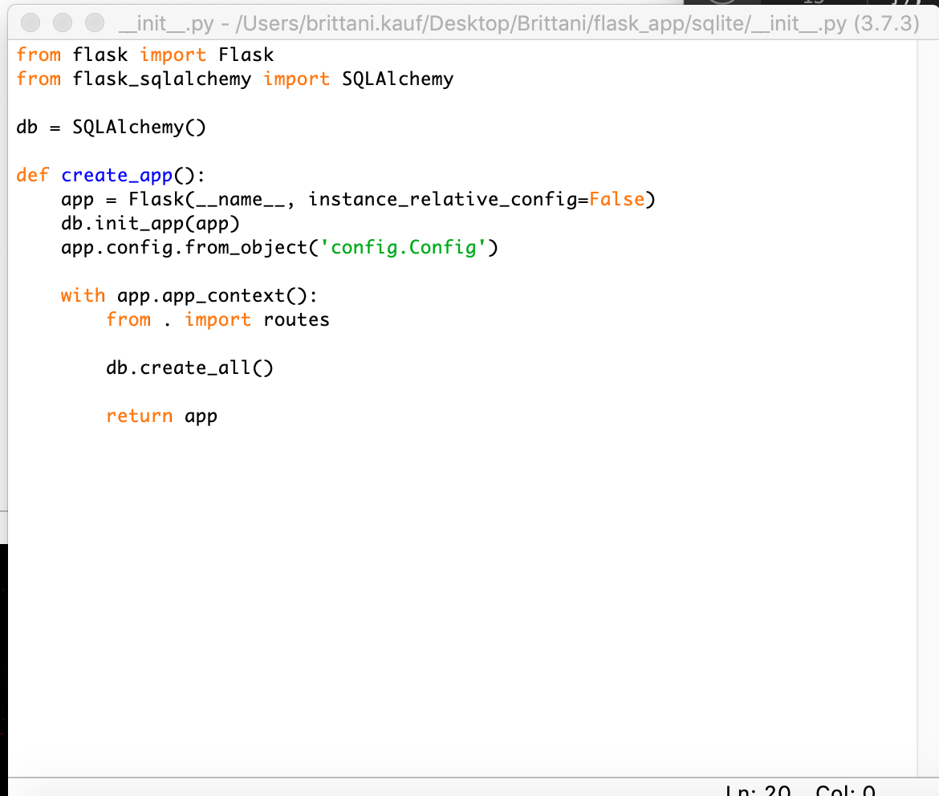
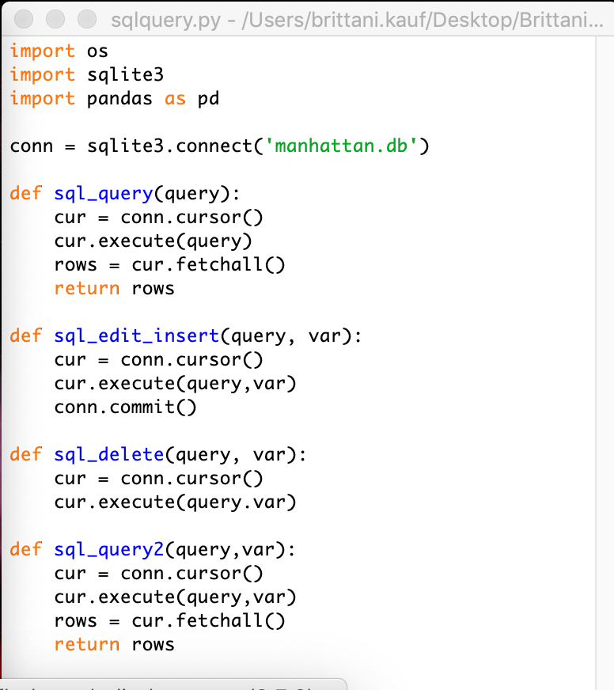
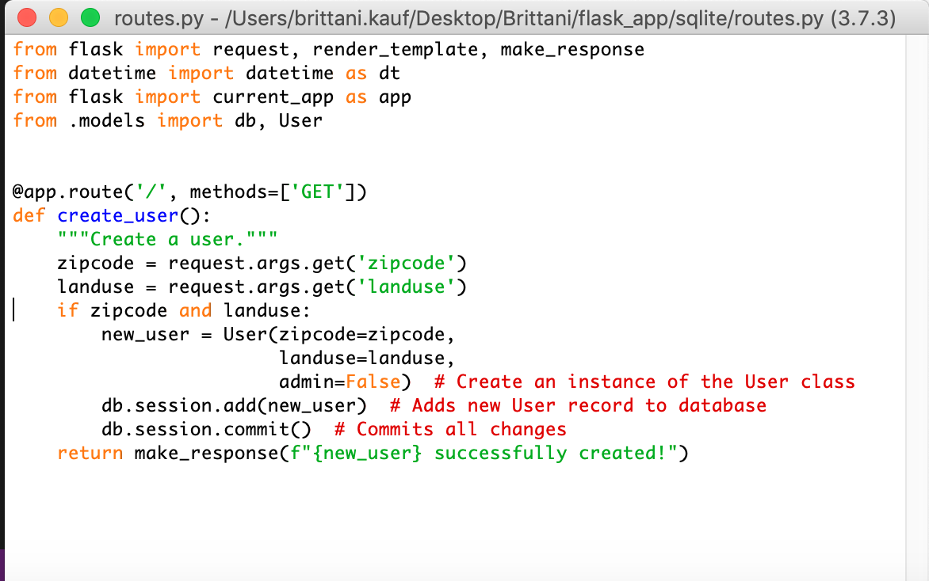
Flask Application

